Slide 1


The World in the Age of AI:
Opportunities, Challenges, and the Future
Nitin Tiwari
Google Developer Expert – Machine Learning
Lead Data Scientist @ Zelar

Slide 2
$whoami
Lead Data Scientist at Zelar [Google Cloud Premier Partner]
Google Developer Expert in Machine Learning
Contributor to Google Dev Library, TensorFlow.js, Gemini and Gemma Cookbooks
Technical Speaker (talks across India, Europe, South East and Central Asia)
Love writing blogs on AI/ML

Slide 3
Content
Part 1: The World in the Age of AI
What is AI · Opportunities · Challenges · The future
Part 2: Sketch2Runway, Gen AI in Fashion
From a pencil sketch to a runway video, with a live demo
Part 3: WebGemma, On-device AI in the Browser
Run Gemma on your own laptop, with a hands-on session
Resources

Slide 4
The World in the Age of AI
PART 1
Notes:
Ask the room: who used Gemini or ChatGPT this week? Everyone. Let's see what is behind it.

Slide 5
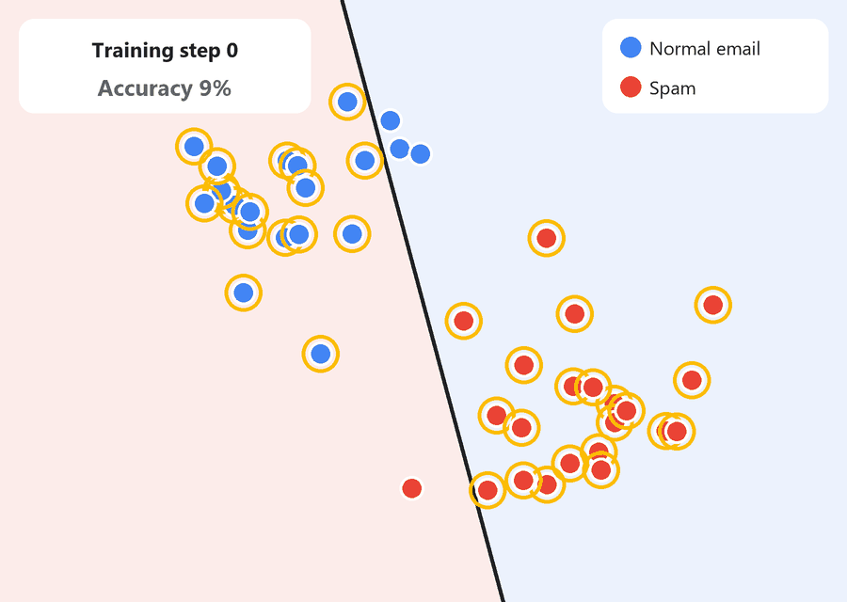
What is AI?
Computers that learn from examples instead of following only rules written by people.
Example
Your email spam filter
Nobody writes a rule for every spam email.
The AI is shown millions of spam and normal emails.
It learns the pattern, and keeps improving as people mark new spam.
Notes:
The animation: each dot is an email. The line is the AI's rule, and it improves with training.

Slide 6






AI You Already Use Every Day
Google Maps
YouTube
Phone camera
Predicts traffic and finds the fastest route
Recommends what to watch next
Face unlock, portrait blur, night mode
Gmail
Google Translate
Gemini & ChatGPT
Filters spam and suggests replies
Translates signs through your camera
Explain, write, summarise and code
Notes:
AI is not new: it has quietly powered the apps students use for years.

Slide 7
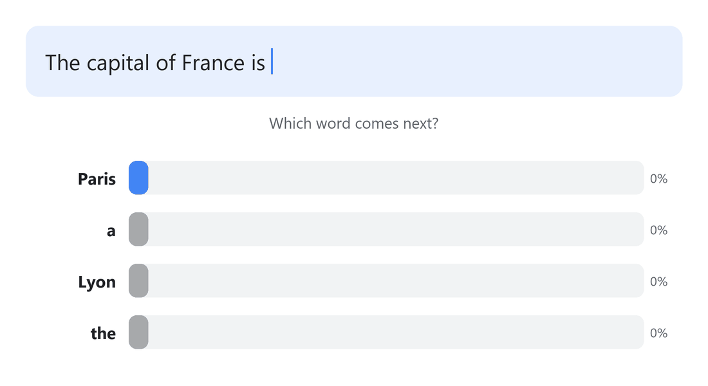
How Do Gemini and ChatGPT Work?
They are Large Language Models: trained on huge amounts of text to predict the next word, one word at a time.
Example
Autocomplete, supercharged
“The capital of France is…” → Paris (92% likely).
Then it predicts the next word, and the next.
Repeat a few hundred times and you get an essay, a poem or working code.
Notes:
Key idea: LLMs pick likely words. Likely is not always true, which matters for Challenges later.

Slide 8
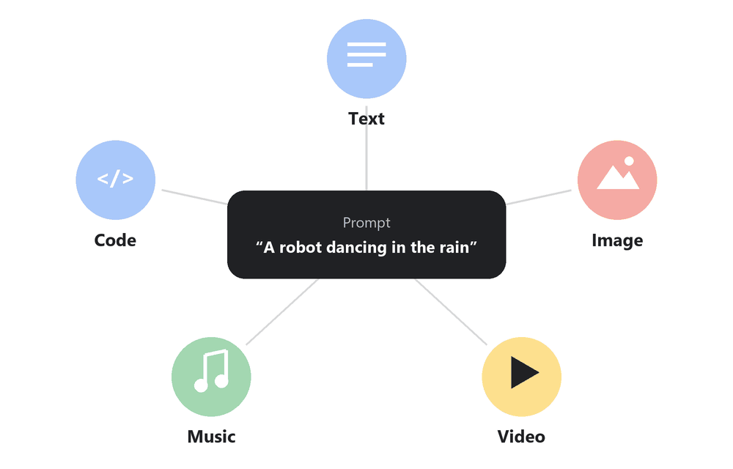
Generative AI: Creating Something New
AI that creates new text, images, video, music and code from a simple prompt.
Example
One idea, five outputs
Prompt: “A robot dancing in the rain”.
Gemini writes the story, Imagen draws the poster, Veo makes the video and Lyria composes the song.
Part 2 shows this for fashion: Sketch2Runway.
Notes:
Imagen = images, Veo = video, Lyria = music: all Google models, also used in Part 2.

Slide 9
Opportunities
Notes:
What AI makes possible: first for you, then for the world.

Slide 10




Opportunities for You
Personal tutor
Coding buddy
Creative partner
Accessibility
Explains any topic at your level and quizzes you before exams
Helps you build your first app and fix bugs
Design, music, video: turn ideas into something real
Live captions, read-aloud and translation for everyone
Use AI to learn faster, not to skip learning.
Notes:
Each card is something students can try tonight, for free.

Slide 11




Opportunities for the World
Healthcare
Science
Climate
Farming
AI helps doctors in India screen for diabetic eye disease from retina photos
AlphaFold predicted 200M+ protein structures and won the 2024 Nobel Prize
Google Flood Hub warns communities of floods up to a week ahead
Farmers photograph a leaf and learn what disease the crop has
AI helps experts do more, faster, for more people.
Notes:
Real projects, not science fiction.

Slide 12




Jobs Are Changing
AI engineer
Data scientist
AI designer
AI ethics & policy
Builds apps and products powered by AI models
Finds patterns in data and trains models
Designs how people and AI work together
Keeps AI fair, safe and accountable
AI won’t replace you. A person who knows how to use AI might.
Notes:
New roles appear, and existing roles (doctor, teacher, designer) change.

Slide 13
Challenges
Notes:
Powerful tools need careful use. Four things every student should know.

Slide 14
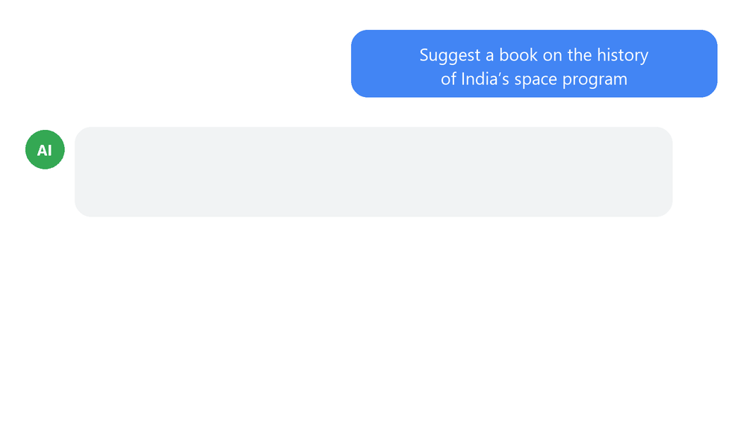
Hallucinations: Confidently Wrong
AI predicts likely words, not true ones, so it can invent facts that sound perfectly right.
Example
The book that doesn’t exist
Ask for a book or a research paper on a topic.
It may give a convincing title, author and year that are made up.
Check important facts in a second, trusted source.
Notes:
Link back to next-word prediction: the model is fluent, not always factual.

Slide 15
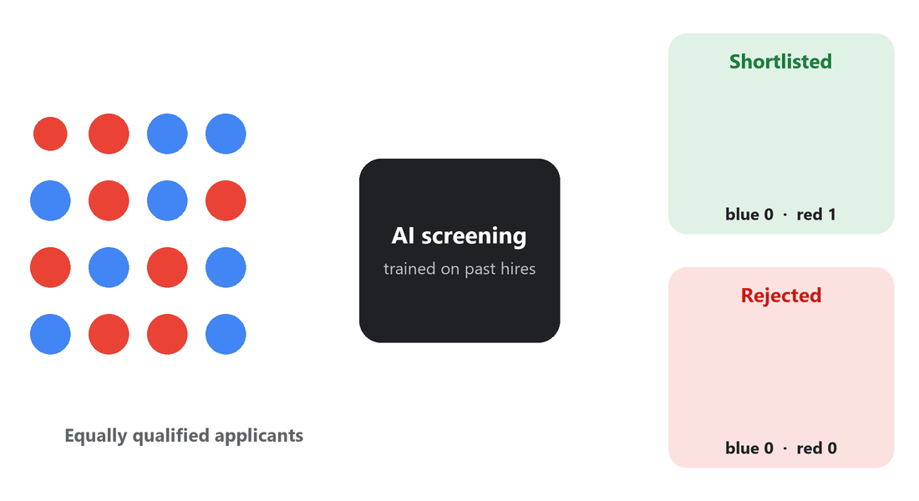
Bias: Unfair Patterns
AI learns from past data. If the past was unfair, the AI can repeat that unfairness, at scale.
Example
A hiring tool that learned the wrong lesson
In 2018, Amazon dropped an experimental hiring AI.
Trained on years of mostly male hires, it scored women’s CVs lower.
Fair AI needs fair data, testing and human checks.
Notes:
Source: Reuters, October 2018.

Slide 16
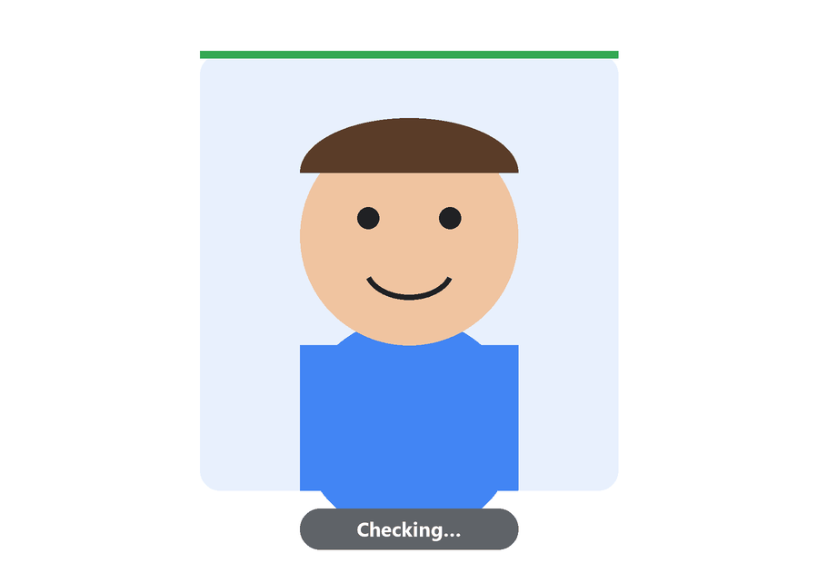
Deepfakes and Misinformation
AI can make fake photos, voices and videos that look real, and they spread fast.
Example
The celebrity “endorsement” scam
Fake videos of famous people promoting investment scams circulate online.
Check the source before you share.
Tools like Google’s SynthID add hidden watermarks so AI-made content can be detected.
Notes:
Simple rule for students: pause, check the source, then share.

Slide 17


Privacy, Jobs and Over-reliance
Privacy
Jobs
Over-reliance
Don’t paste passwords, personal details or private documents into chatbots
Routine tasks will change, so build skills AI can’t easily copy
If AI writes your homework, you don’t learn the subject
Use AI as a co-pilot, not an autopilot.
Notes:
Three habits for responsible everyday use.

Slide 18
The Future
Notes:
Where AI came from, and where it is going next.

Slide 19
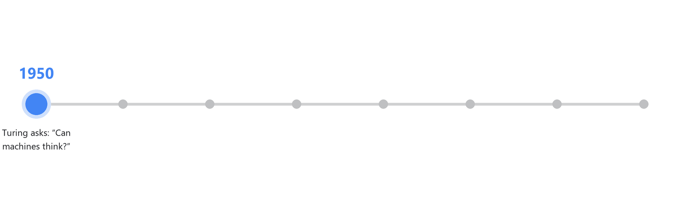
How We Got Here
Most of this happened in the last 10 years, within your lifetime.
Notes:
75 years in one line. The pace is accelerating: notice the gap between dots shrinking.

Slide 20



What’s Next
AI agents
Multimodal AI
On-device AI
AI for science
Assistants that complete tasks for you: plan, book and fill in forms
AI that sees through your camera and talks in real time
Runs privately on your phone or browser, even offline (Part 3)
Discovering new medicines and materials faster
The future of AI will be built by people your age.
Notes:
These are already in early products today.

Slide 21



How to Get Ready
Stay curious
Learn to prompt
Verify
Build something
Try Gemini, Google AI Studio and NotebookLM
Give a clear goal, context and an example
Check facts and sources before you trust or share
Teachable Machine: train your own AI, no code needed
The best way to understand AI is to build with it.
Notes:
End Part 1 with action: every card is something to try this week.

Slide 22
Sketch2Runway: Gen AI in Fashion
PART 2
Notes:
Sketch2Runway slides are inserted after this divider by insert_sketch2runway.ps1.

Slide 23
Content
Introduction
AI in Fashion
Introduction to Google Gen Media
About Sketch2Runway
Project Demonstration
Resources

Slide 24
Introduction

Slide 25
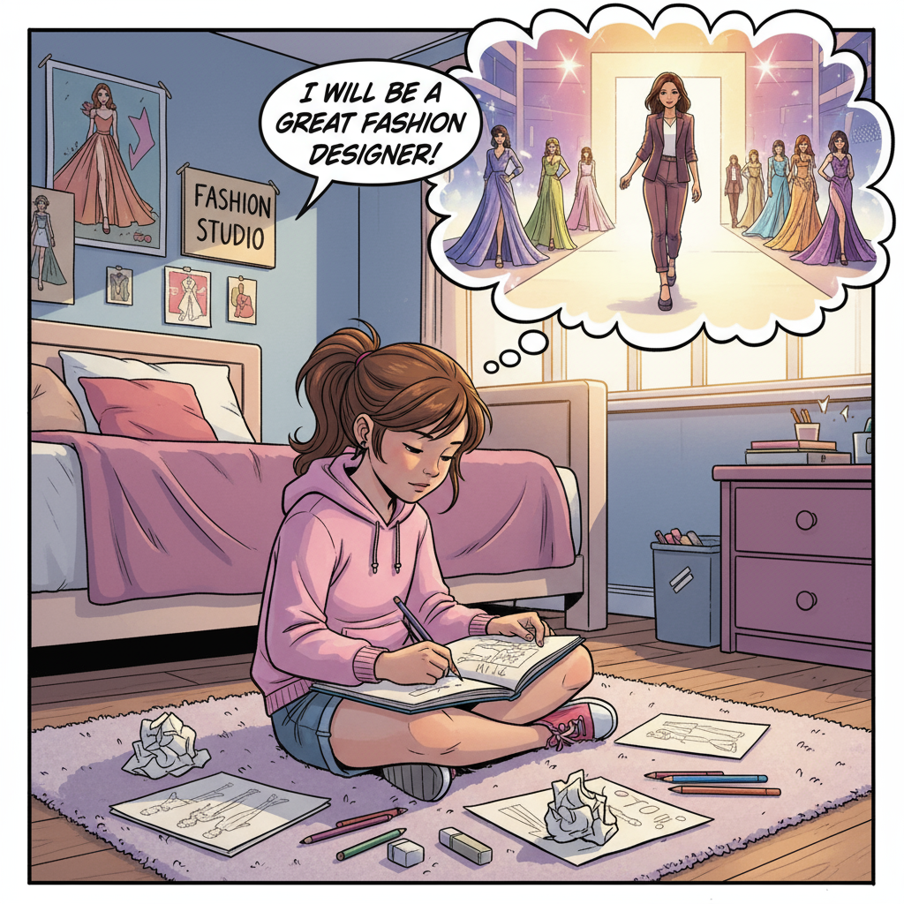
Introduction
Every expert in a field starts small – with scribbles, mistakes, and dreams.
Meet Mira. She’s not a designer yet, but she has big dreams.
She spends hours sketching in her room, imagining her creations on the runway.
But the path from sketchbook to spotlight is full of challenges like time, cost, and limited access to resources.
What if technology could help dreamers like Mira bring their fashion visions to life?
That’s where Generative AI comes in.

Slide 26
AI in Fashion

Slide 27
AI in Fashion
AI is transforming the fashion industry by personalizing customer experiences through virtual try-ons, and AI-powered stylizations.
Accelerate designs by generating new clothing concepts and enabling rapid prototyping from sketches.
AI-powered visual search helps customers find products faster by uploading images or photos.
Brands use AI for demand forecasting and inventory optimization to reduce waste and improve sustainability.

Slide 28
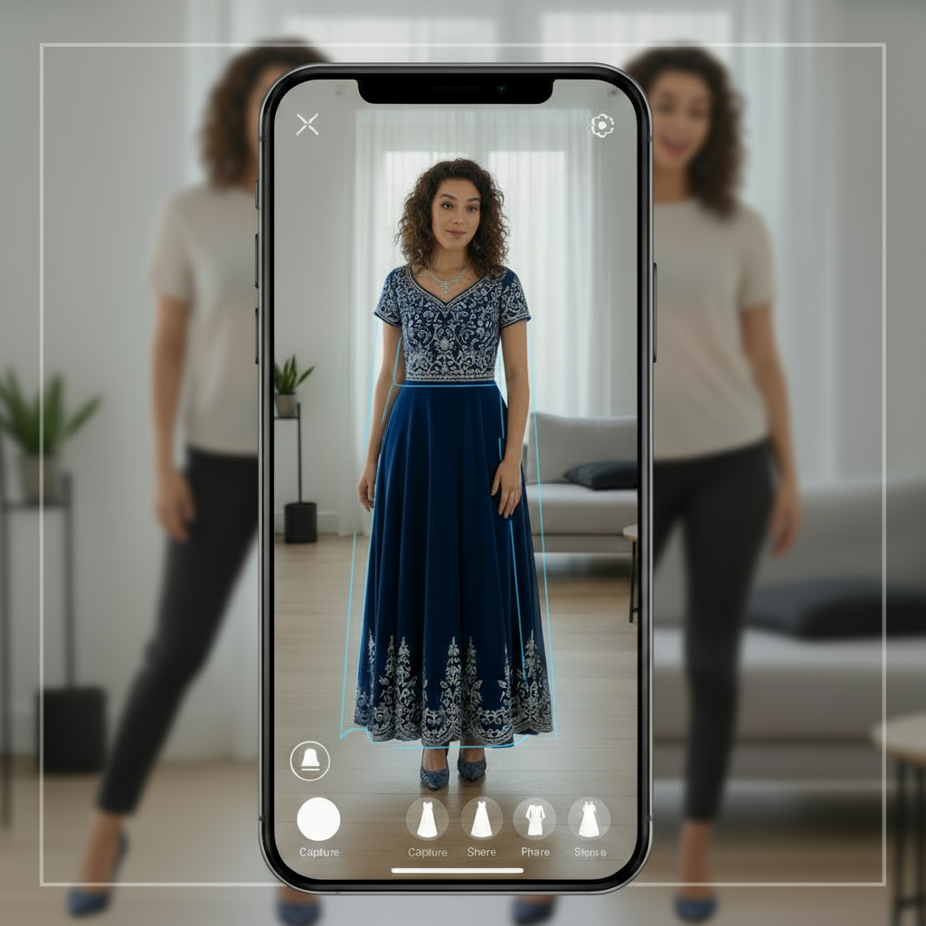
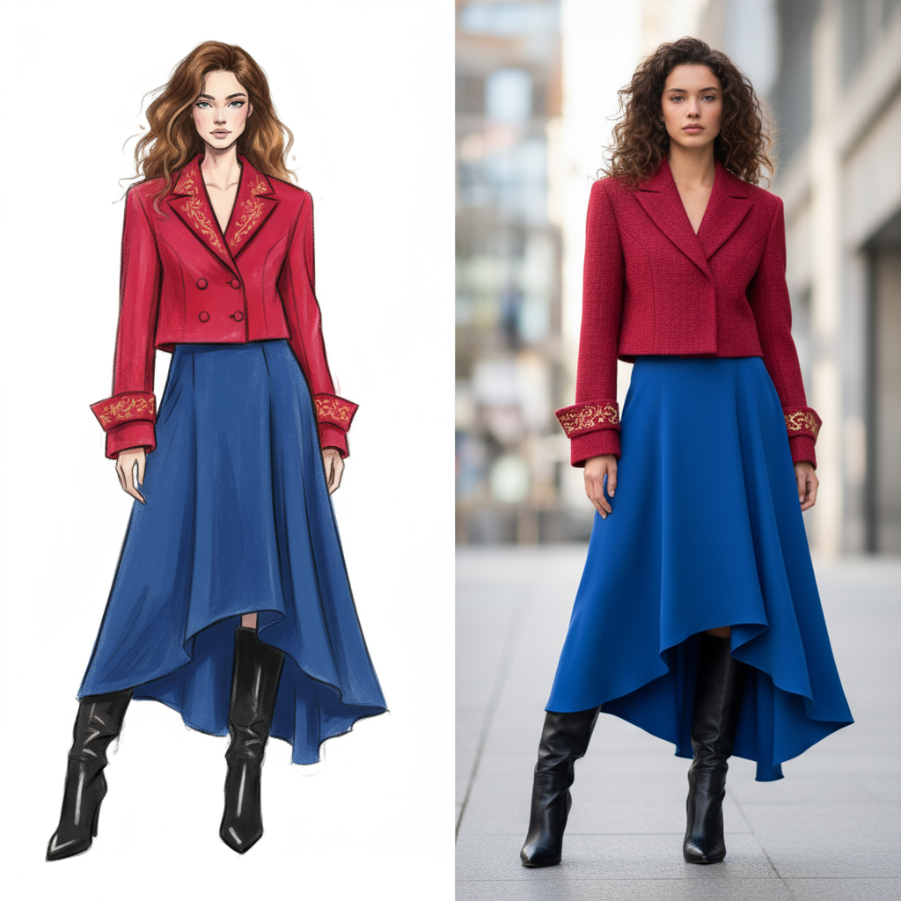
Virtual Try-On
Sketch2Design

Slide 29




Fashion Industry using AI
Generative design of sneakers
AR-powered virtual try-ons for shoes and accessories
and many more …
Analyze customer preferences and social media trends
AI for supply chain optimization and predictive analysis

Slide 30

Google Cloud
Gen Media on Vertex AI

Slide 31
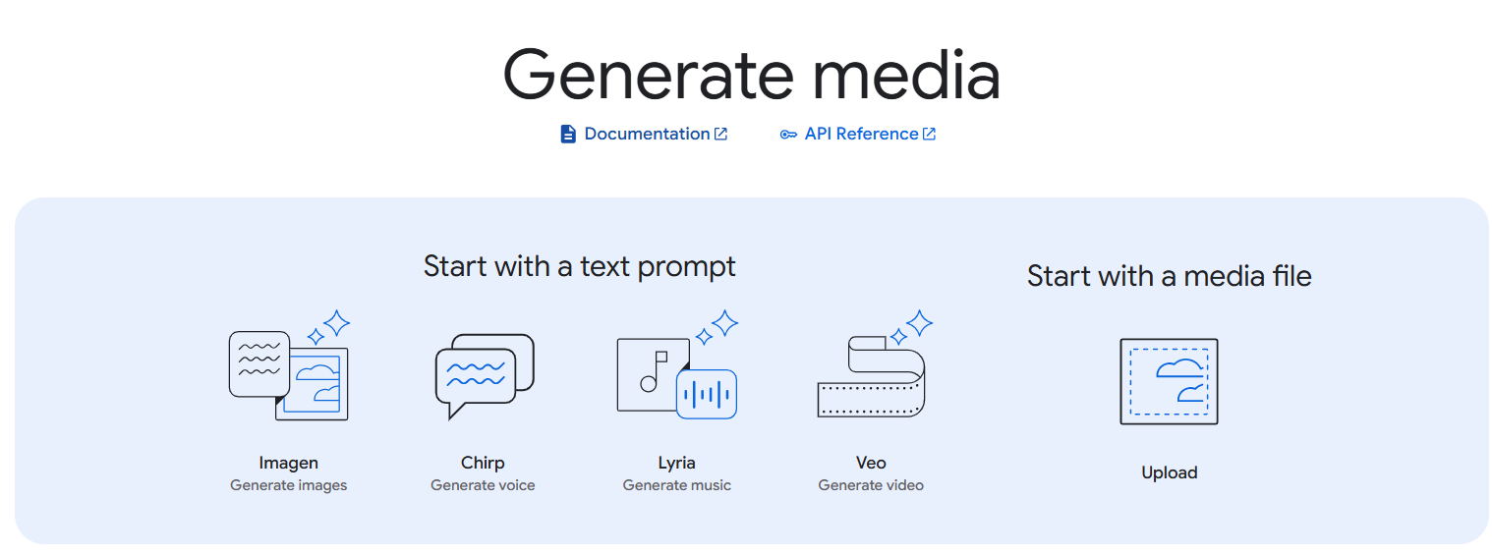
Google Cloud Gen Media
Google Cloud provides a suite of generative AI tools on Vertex AI called Gen Media, designed to help businesses create high-quality media content.
These tools use advanced AI models to generate images (Imagen), videos (Veo), music (Lyria), voice (Chirp), etc. enabling more engaging and personalized customer experiences.

Slide 32


Fashion Sketch2Runway
Nitin Tiwari
AI GDE
Margaret Maynard-Reid
AI GDE

Slide 33
Fashion Sketch2Runway
Developed in collaboration with fellow AI GDE Margaret Maynard-Reid, Sketch2Runway is a project that showcases Google’s Generative AI models Gemini 2.5 Flash (Nano Banana 🍌) and Veo 3 for fashion design.
It converts your sketch to a beautiful fashion photo which you can edit and then turn it into a stunning 8-second video with the start-of-art video generation model Veo 3.

Slide 34
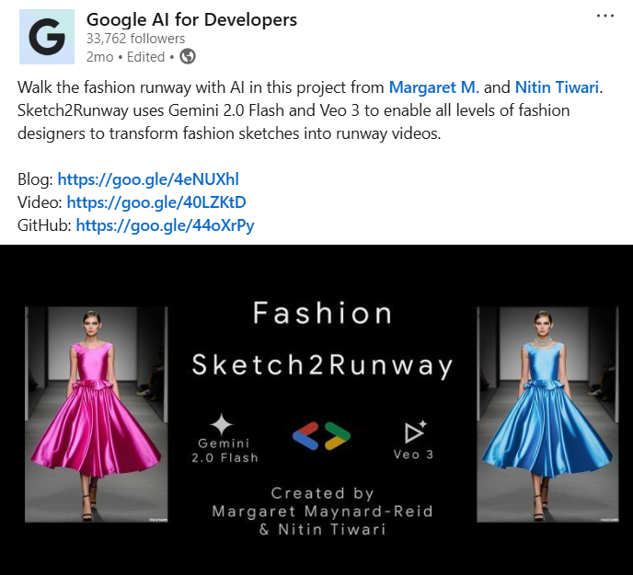
**This project was featured by the official handle of Google AI for Developers**

Slide 35
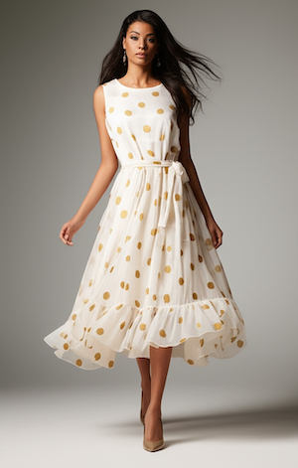
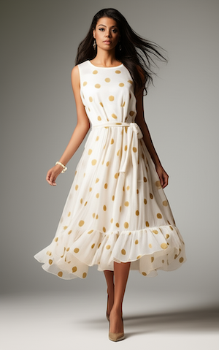

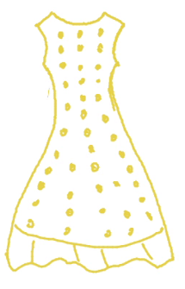
Fashion Sketch2Runway – Pipeline
Step 1: Draw Sketch
Step 2: Generate Image
Step 3: Edit Image
Step 4: Generate Video
Convert the sketch to a photorealistic full body portrait of a fashion model wearing a chic dress
Add a beautiful matching bracelet that goes well with her dress
She walks forward gracefully with a smile. Add runway music
Input
Gemini 2.5 Flash
Gemini 2.5 Flash
Veo 3

Slide 36
Project Demonstration

Slide 37
Steps to Install
Clone the repository on your local machine.
Navigate to cd sketch2runway directory.
Run pip install -r requirements.txt to install the packages.
Open .env file and configure your GEMINI_API_KEY, GCP_PROJECT_ID, GCP_BUCKET_NAME.
Run flask run to start the server.
Open localhost:5000 on your web browser to bring up the web UI.

Slide 38
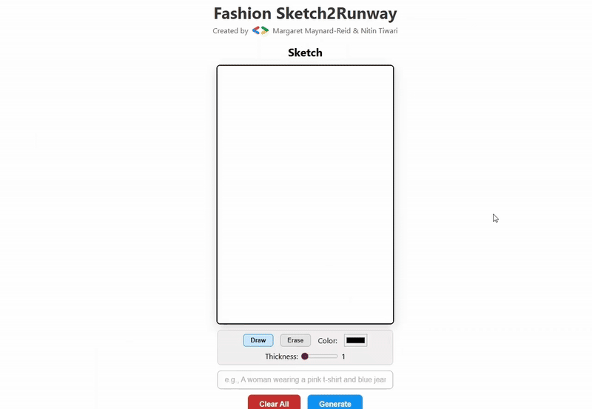
Demonstration

Slide 39
Resources

Slide 40
Resources
GitHub repository:
https://github.com/margaretmz/sketch2runway
Colab notebook:
https://github.com/margaretmz/sketch2runway/blob/main/Sketch2Runway.ipynb
YouTube Tutorial:
https://www.youtube.com/watch?v=9Bo5sEVoVQk
Medium blog:
https://medium.com/google-developer-experts/fashion-sketch2runway-with-gemini2flash-veo3-ced1e2776fea
Gemini API documentation:
https://ai.google.dev/gemini-api/docs
Vertex AI Studio:
https://console.cloud.google.com/vertex-ai/studio/

Slide 41
WebGemma: On-device AI in the Browser
PART 3
Notes:
WebGemma slides follow unchanged.

Slide 42
Content
Introduction to Vision Language Models
Architecture of a typical VLM
Google’s open VLMs
Introduction to Gemma 4
Matryoshka Transformer (MatFormer)
Hands-on: Inference Gemma 4 on the browser
Demo: Serve and inference Gemma 4 on TPUs
Resources

Slide 43
Vision Language Models

Slide 44
Vision Language Models
Vision Language Models are multimodal models that learn from images and text, generating text outputs from image and text inputs.
They excel in zero-shot capabilities, generalization, and various tasks like image recognition, question answering, and document understanding.
These models can also capture spatial properties and output bounding boxes or segmentation masks for specific subjects.

Slide 45
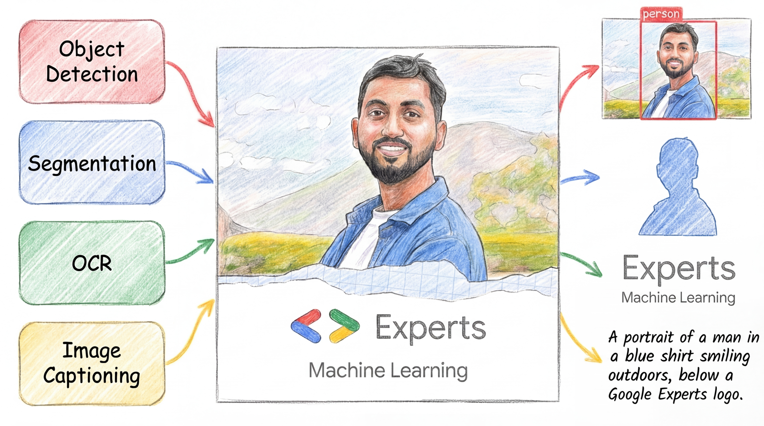
Vision Language Models

Slide 46

Architecture of a typical VLM
Text Output
Text Decoder
Text Decoder
Projected visual tokens + text embedded tokens
Multimodal Projector
Text Prompt
Image Encoder
Multimodal Projector
Text Prompt
{CLIP, SigLIP, MobileNet v5 etc.}
Frozen (not trainable)
Not frozen

Slide 47
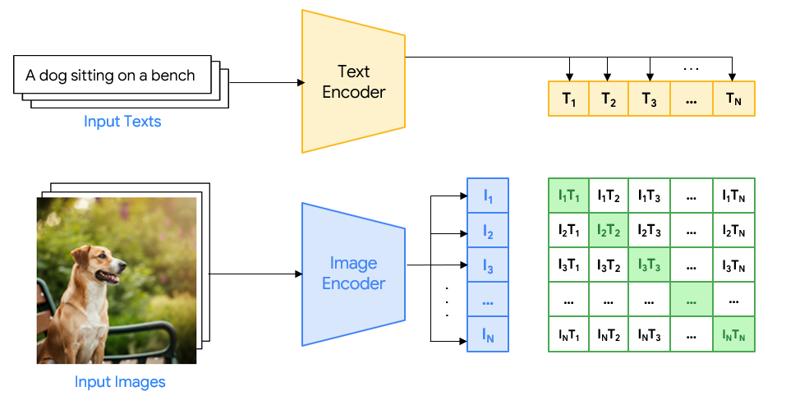
Example: Contrastive Pre-training

Slide 48
Google’s open VLMs

Slide 49
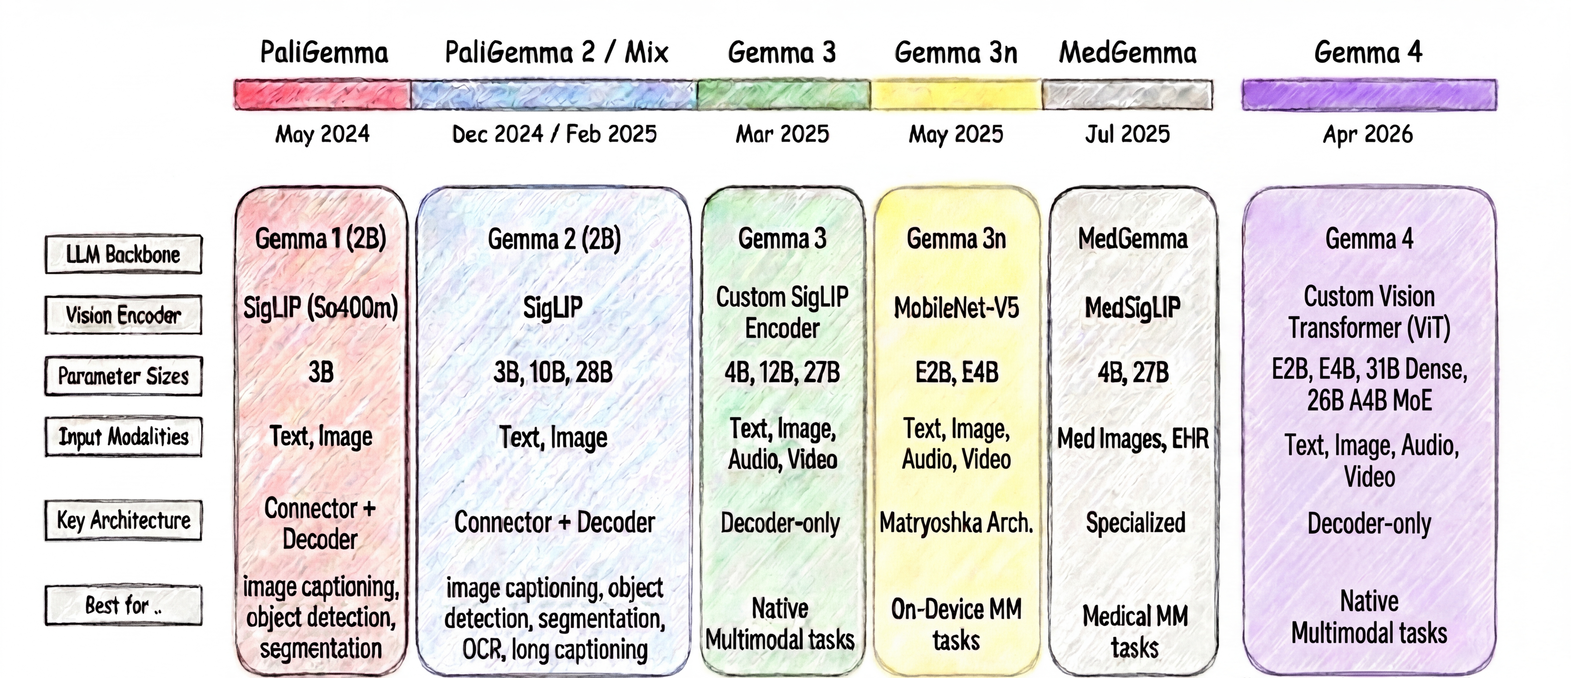
Google’s Open VLMS - History

Slide 50
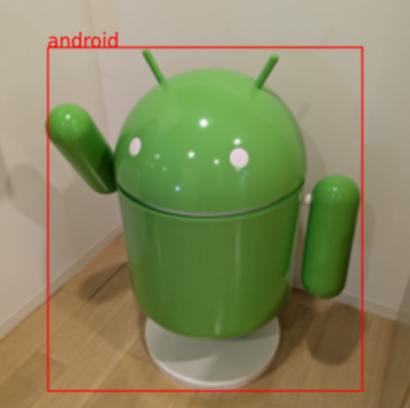

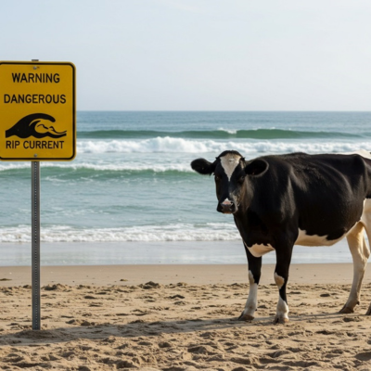
PaliGemma 2 Mix
PaliGemma 2 Mix is tuned to a mixture of tasks (PT + FT) for common use cases like object detection, segmentation, OCR, short and long captioning, and visual question answering.
Official support from Google for frameworks like Hugging Face Transformers, Keras, PyTorch, JAX, etc.
Open-source contribution: ONNX implementation of PaliGemma 2 to run on the browser using Transformers.js.
Object Detection
Segmentation
OCR
WARNING
DANGEROUS
RIP CURRENT
Image source: https://developers.googleblog.com/introducing-paligemma-2-mix/

Slide 51
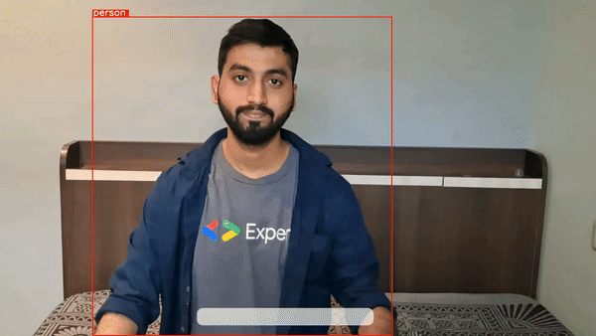
Zero-shot Object Detection
PaliGemma is capable of zero-shot object detection, meaning, without training the model on specific datasets, it can detect objects with just a text prompt.

Slide 52
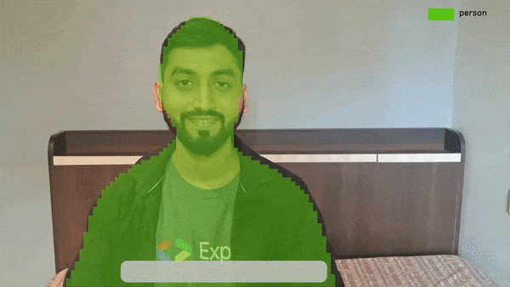
Instance Segmentation
PaliGemma can also segment objects in images and videos merely using a text prompt.

Slide 53
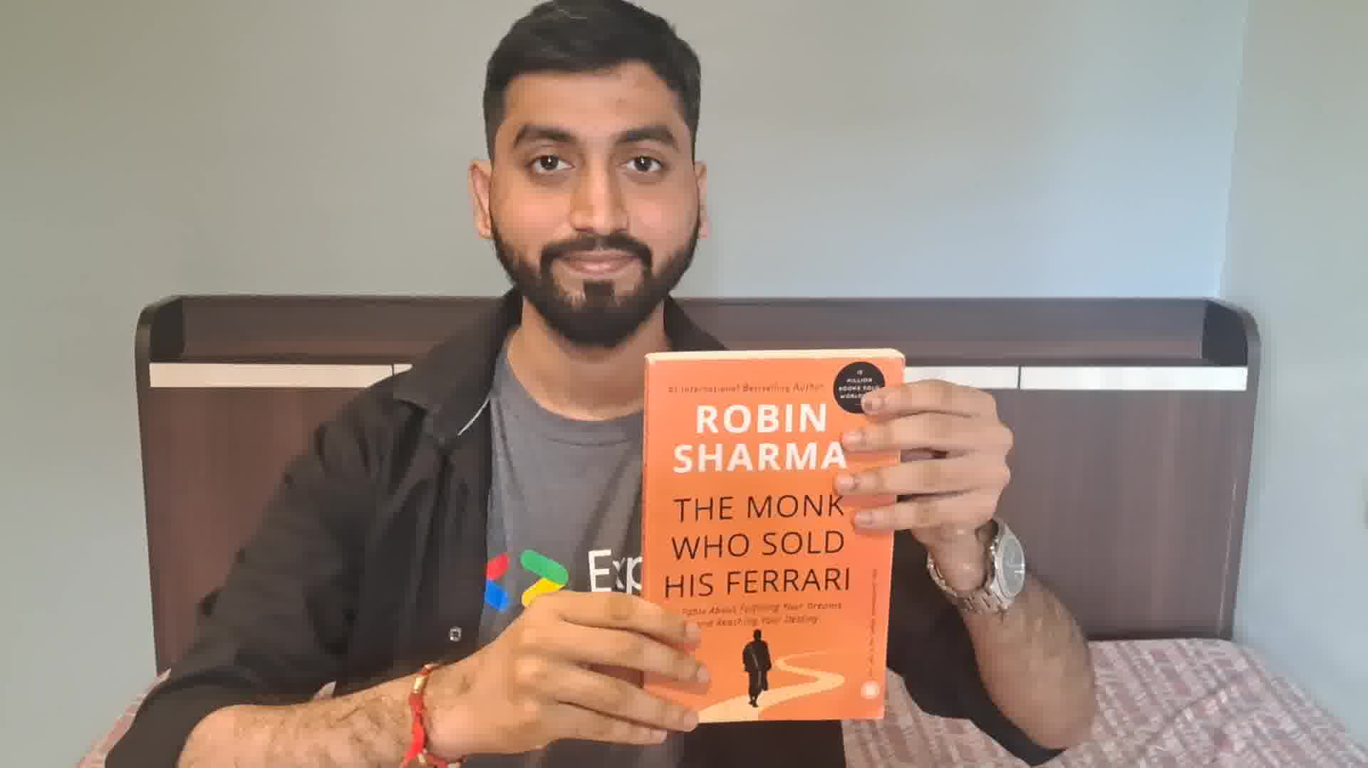
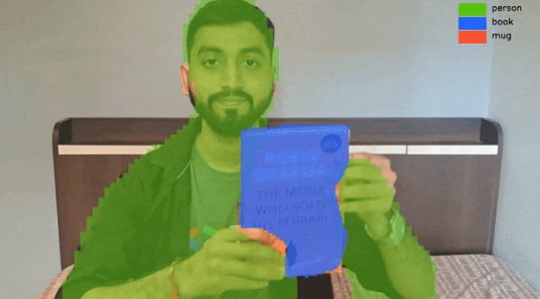


How does it work?
Text Prompt: Segment person, mug, book
<loc100><loc200><loc300><loc400><seg058><seg071> … person
Parse the output from PaliGemma 2 model and draw segmentation mask on the input image.
<loc50><loc80><loc120><loc400><seg064><seg082> … book

Slide 54
Gemma 4

Slide 55
Gemma 4
Gemma 4 is the latest open, multimodal model designed for on-device AI use cases including thinking, coding, multilingualism, agentic workflows, image understanding, and a lot more.
Available in E2B and E4B, corresponding to approximately 5B and 8B raw parameters, 31B Dense, and 26B A4B MoE
Supports multiple input modalities including text, images, audio (max 30 secs), and video (max 60 secs).
Does NOT use MatFormer (Matryoshka Transformer) architecture anymore. E2B and E4B are separately trained models.
Includes PLE caching (Per-Layer Embedding caching), which allows embeddings to be stored in fast local memory to reduce runtime memory and compute overhead.

Slide 56
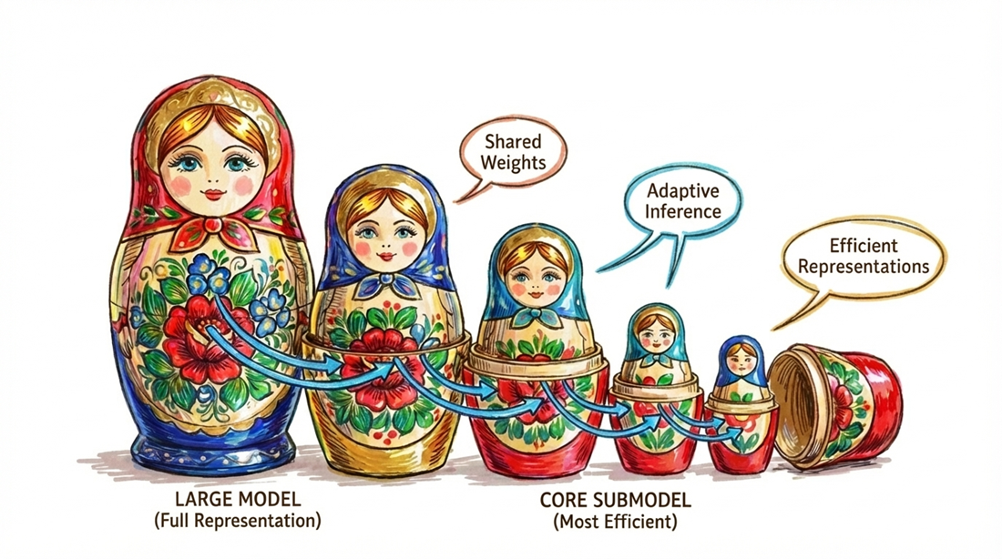

Matryoshka Transformer (MatFormer)
A nested transformer architecture inspired by Matryoshka dolls
Organizes model parameters into multiple embedded sub-models of increasing size
Activates only the required subset of parameters per request
Enables dynamic scaling of compute based on task complexity
Allows smaller “inner” models to run independently when resources are limited

Slide 57
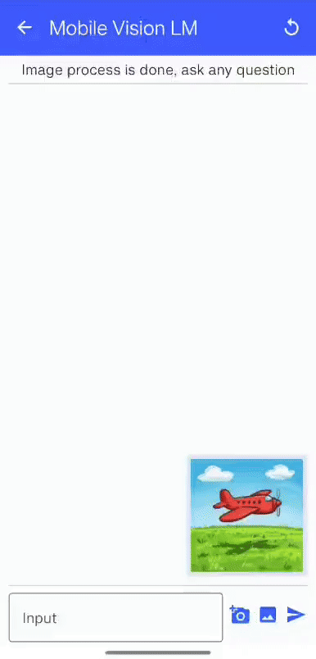
Mobile Vision LM
Custom vision language model that uses SigLIP as the vision encoder and Phi-2 as the language decoder.
Repository
https://github.com/NSTiwari/Mobile-VisionLM
Implementation
Converted Imp v1 3B model weights using MLC (Machine Learning Compilation) framework
Quantize the model weights to q4f16
Bundle the model weights
Deploy on Android
**Custom on-device Vision Language Model on Android**

Slide 58
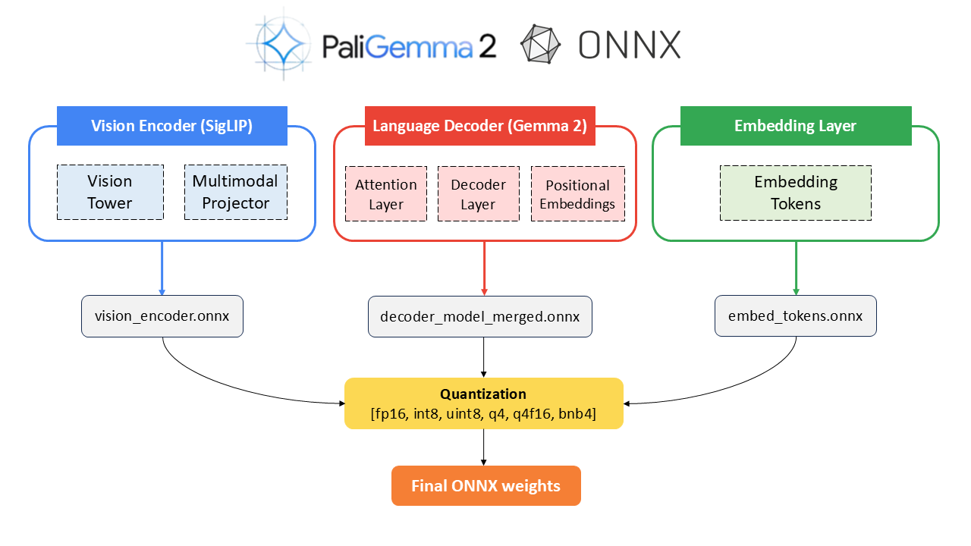
Bonus: Learn how to quantize and convert PaliGemma 2 to ONNX
github.com/NSTiwari/PaliGemma2-ONNX-Transformers.js

Slide 59
Hands-on:
Inference Gemma 4 on the browser

Slide 60
Steps to get started:
Step 1: Clone or download the below repository
https://github.com/NSTiwari/Gemma-4-on-Browser
Step 2: Navigate to the directory
Step 3: Install necessary libraries and dependencies
Step 4: Start the Node.js server
Step 5: Start inferencing on your browser, all on-device
cd “Gemma-4-on-Browser”
npm install
node server.mjs
https://localhost:3000

Slide 61
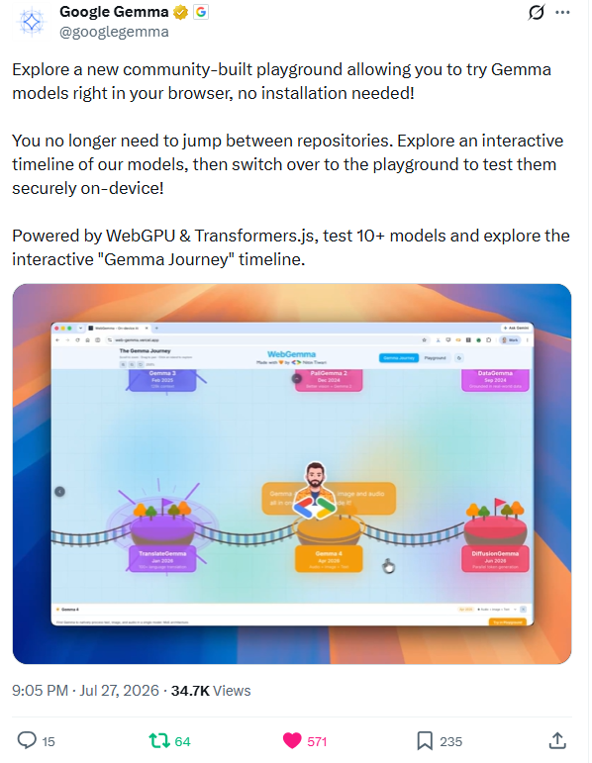
WebGemma
WebGemma is a browser-based playground that lets you try 10+ Gemma models (including Gemini Nano) directly on the browser without any installation.
It uses WebGPU and Transformers.js to run these models offline and on the browser.
Includes models like Gemma 4, Gemma 3n, PaliGemma 2 Mix, TranslateGemma, EmbeddingGemma, and Gemini Nano.
Try it now:
https://github.com/NSTiwari/WebGemma
https://web-gemma.vercel.app/

Slide 62
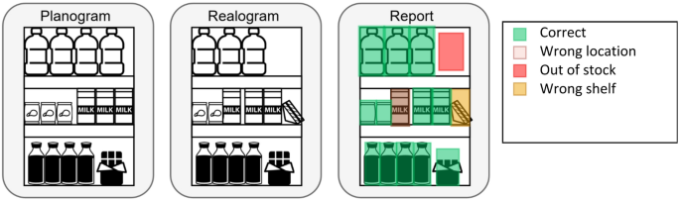
Project 1: "Offline Inventory & QA Tracker for Planogram Compliance" (Retail/Manufacturing)
The Problem: Warehouses and retail stores need to count stock or detect defects, but internet connectivity in warehouses is often terrible.
"Detect bottles, boxes, and cans."

Slide 63
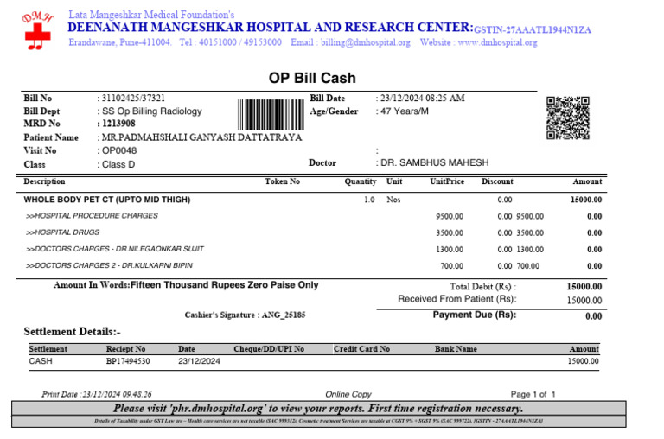
Project 2: "Privacy-First Medical/Legal Analyzer" (Healthcare/Finance)
The Problem: Doctors and lawyers cannot upload patient records, receipts, or legal documents to cloud because it violates data privacy laws (HIPAA/GDPR).
“Extract the patient name, date of birth, and prescribed medication in JSON format.”

Slide 64
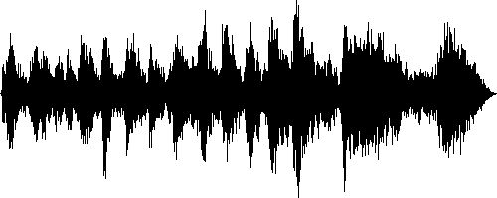
Project 3: “On-device phone call summarizer”
The Problem: Phone calls contain our most sensitive data like banking details, medical issues, corporate secrets, and personal gossip. People want AI to transcribe and summarize their calls, but uploading a personal phone call to a cloud server is a massive privacy violation and often breaches corporate security policies.
"Transcribe this phone call verbatim. Then, provide a bulleted summary, highlight the action items, and extract any dates, times, or phone numbers mentioned."

Slide 65
Serve Gemma 4 on TPU

Slide 66
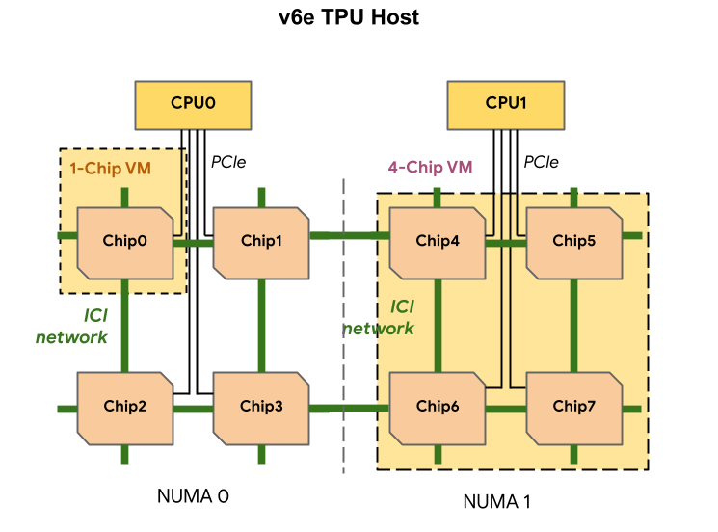
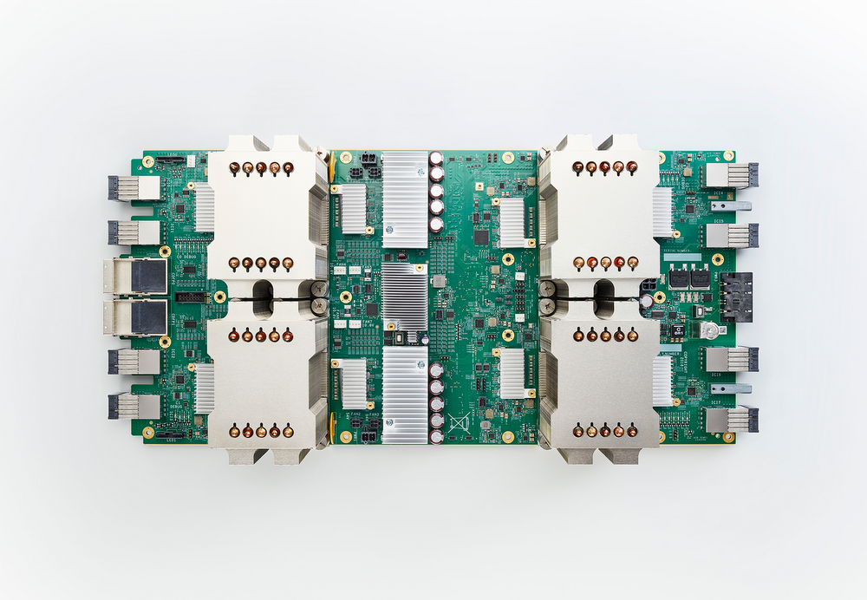
Gemma 4 on TPU
Gemma 4 can be served on Cloud TPUs for seconds to sub-second inferencing using vLLM.
This example shows how to serve Gemma 4 26B-A4B-it MoE model on TPU v6e (Trillium) on Google Cloud using vLLM.

Slide 67
Serve Gemma 4 on TPU
export PROJECT=YOUR_GCP_PROJECT_NAME
export HF_TOKEN=YOUR_HF_TOKEN
export ZONE=us-east5-a
export TPU_NAME=gemma4-tpu-vllm
Configure env variables
gcloud alpha compute tpus queued-resources create gemma4-tpu-vllm \
--zone=us-east5-a \
--accelerator-type=v6e-4 \
--runtime-version=v2-alpha-tpuv6e \
--node-id=gemma4-tpu-vllm \
--provisioning-model=flex-start \
--max-run-duration=4h \
--valid-until-duration=4h \
--labels=purpose=flex-start
Create a v6e TPU VM instance

Slide 68
gcloud compute tpus tpu-vm ssh gemma4-tpu-vllm \
--zone=us-east5-a
SSH into the VM
sudo docker run -it --rm --name gemma4-vllm \
--privileged \
--network host \
--shm-size 16g \
-v /dev/shm:/dev/shm \
-e HF_TOKEN=$HF_TOKEN \
vllm/vllm-tpu:gemma4 \
python -m vllm.entrypoints.openai.api_server \
--model google/gemma-4-26B-A4B-it \
--tensor-parallel-size 4 \
--max-model-len 8192 \
--limit-mm-per-prompt '{"image": 1, "audio": 0}' \
--disable_chunked_mm_input \
--enable-auto-tool-choice \
--tool-call-parser gemma4 \
--host 0.0.0.0 \
--port 8000
Download Gemma 4 Docker image

Slide 69
Inference Gemma 4 on TPU
Step 1: Clone or download the below repository
https://github.com/NSTiwari/Gemma-4-on-TPU
Step 2: Navigate to the directory
Step 3: Edit External IP address
Step 4: Start the Python server
Step 5: Start inferencing Gemma 4 on Cloud TPU
cd “Gemma-4-on-TPU”
Replace YOUR_EXTERNAL_IP on line 583 in index.html
py –m http.server
https://localhost:3000

Slide 70
Resources

Slide 71
Resources
Inference Gemma 4 on Browser
https://github.com/NSTiwari/Gemma-4-on-Browser
Gemma Cookbook
https://github.com/google-gemini/gemma-cookbook
Gemma 4 official documentation
https://ai.google.dev/gemma/docs/core/model_card_4
Serve and inference Gemma 4 26B-A4B-it on Cloud TPU
https://medium.com/google-developer-experts/serve-and-inference-gemma-4-on-tpu-ae7da212ddd4
Google AI Edge
https://ai.google.dev/edge

Slide 72





Thank You.
linkedin.com/in/tiwari-nitin
medium.com/@tiwarinitin1999
twitter.com/@NSTiwari21
github.com/NSTiwari

